Slide 1
Inroduction Of Staf
Meng Yang
meyang@redhat.com
2015.4

Slide 2
Agenda
The DIR Structure of autotest
How it works in command line
The Doc of autotest

Slide 3
The DIR Structure
We have 2 root Dirs:
Staf-kvm-devel :
git://qe-git.englab.nay.redhat.com/s2/autotest-devel
Autotest-devel:
git://qe-git.englab.nay.redhat.com/s2/staf-kvm-devel
Note: Clone it to local to check the dir.

Slide 4
Autotest-devel
Autotest-devel
Tp-qemu
Virt-test
Autotest
Autotest-client-tests
Autotest-server-tests
tp-libvirt
tp-qemu
Autotest-client-tests
Virt-test
tp-libvirt
Autotest-devel
Autotest-server-tests
Autotest

Slide 5
Autotest-devel
Relative path in autotest-devel:
Qemu case dir:
./qemu/cfg
Autotest-client-tests
./client/tests
Virt-test
./Client/tests/virt
./client/tests/virt/test-providers.d/downloads/io-github-autotest-qemu
Tp-qemu
Tp-libvirt
./client/tests/virt/test-providers.d/downloads/io-github-autotest-libvirt

Slide 6
Staf-kvm-devel
Dir Tree:
.
|-- Doc
|-- internal_cfg
|-- internal_ks
|-- qemu
|-- shared
|-- other files
`-- xml
Doc
|-- sriov.txt
`-- Virtual_Network
|-- macvtap
`-- openvswitch
internal_cfg/
|-- base-internal.cfg
|-- guest-hw-internal.cfg
|-- guest-os
|-- host-kernel
|-- subtests-internal.cfg
`-- test_loops
[other files]
README --> Talks about how to use Staf to run cases and parameter intro.
ConfigTest.py --> Entry point to run case using Staf
ConfigLoop.py --> Entry point to run loop(case set) using Staf
virt.cfg --> predefined var like guest-name,platform etc for virtlab

Slide 7
ConfigTest
How ConfigTest works

Slide 8
ConfigTest.py
1) Generate the dict using the variables in the command line,
Such as: python ConfigTest.py --guestname=Win2008 --platform=x86_64 --testcase=mig2.noload.round_def --mem=8192 --vcpu=8
2) In wrapper.py,there is a predefined dict. handle the command line in the function “build_dict_from_argv” ,it will generate the dict item from the commd-line parameter and add them to the dict.
3) Generate the fixup
the function “common_parameter_parse” will generate a big string for our test-examples.cfg using the dict
4) Continue to add fixup string, it will add pre_test,run_test and post_check testcases.for example: unattended,kernel_update,check_coredump,also the case we want to run.

Slide 9
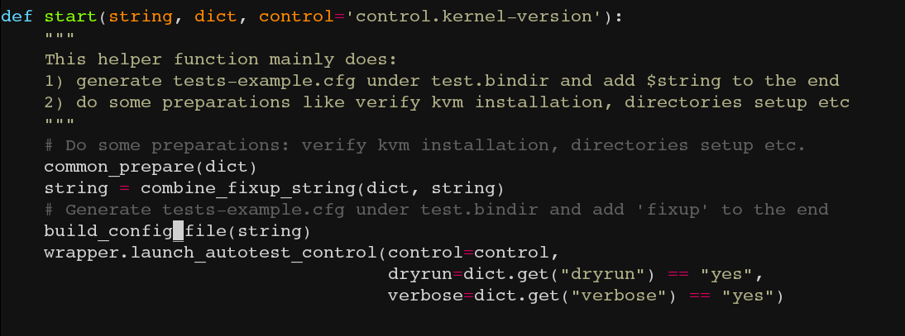
ConfigTest.py

Slide 10
ConfigTest.py
5) after all the fixup string generation,it will prepare the env for our test.
In common.py, the function “common_prepare” will do the env setup,it will call the func defined in env_setup.py :
(1) read content from “env_setup.cfg”,generate them to our dict.
It just has the nfs info for our iso and img
(2) kvm_verify, stop_iptables, brew_koji verify, qemu-ifup/ifdown script creation, vhost_net module loading and etc.
(3)Prepare the directories and the soft links,and now you will know why you will need to link kvm-test to the autotest-devel
ln -s /home/autotest/autotest-devel/client /home/autotest/staf-kvm-devel/kvm-test

Slide 11
ConfigTest.py
(4) This is mainly done in the func “directory_setup”,there is several useful directories:
/home/kvm_autotest_root
|-- images → imgs installed or copied by autotest will be in there
|-- images_nfs → will be used if you specify –use_storage=nfs
`-- iso → will be linked to kvm-test/tests/virt/shared/data
10.66.90.128:/vol/S2/kvmauto/windows_img → /mnt/windows #windows imgs
10.66.90.128:/vol/S2/kvmauto/linux_img → /mnt/linux #linux imgs
--use_storage=local_stg is the default,it will then link the img path:
/home/kvm_autotest_root/images → kvm-test/tests/virt/shared/data/images
Create several soft links such as “/usr/libexec/qemu-kvm','/usr/bin/qemu-kvm”

Slide 12
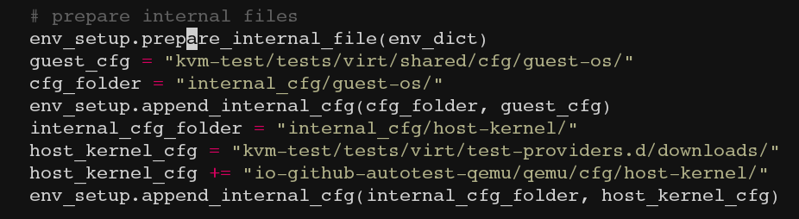
ConfigTest.py
5)Prepare internal files: func common_prepare(dict)
env_setup.prepare_internal_file(env_dict):
1)copy kvm-test/tests/virt/shared/data/isos/windows/cdkeys.cfg to kvm-test/tests/virt/test-providers.d/downloads/io-github-autotest-qemu/qemu/cfg/
2)copy internal_cfg/* to kvm-test/tests/virt/test-providers.d/downloads/io-github-autotest-qemu/qemu/cfg/
2)copy internal_ks/* to kvm-test/tests/virt/shared/unattended/
Note: this func only copies the file(not including the dir)

Slide 13
ConfigTest.py
(6)Prepare internal configurations:
Done by the func “append_internal_cfg”:
1)if the file in internal_cfg/guest-os doesn't exist in “kvm-test/tests/virt/shared/cfg/guest-os/” ,just copy it.
2)if the file in internal_cfg/guest-os exists in “kvm-test/tests/virt/shared/cfg/guest-os/”, combine the 2 files into one new file in “kvm-test/tests/virt/shared/cfg/guest-os/” ,it means put the content of the 2 files into one.
3) for host-kernel/ ,it works the same.

Slide 14
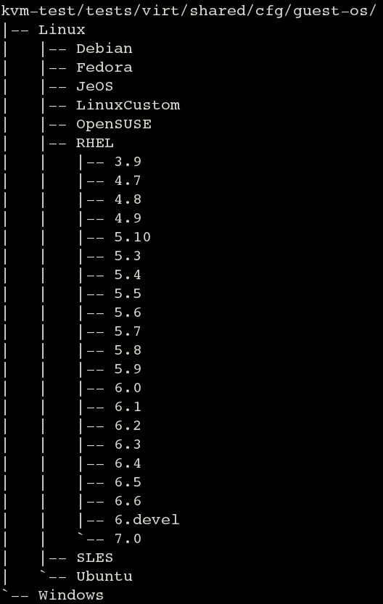
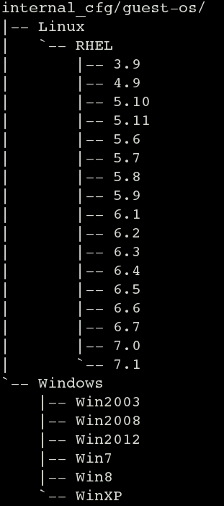
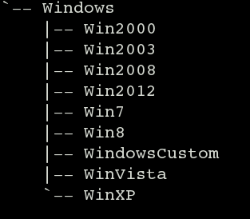

Slide 15
ConfigTest.py
(7) combine fixup and generate tests-example.cfg
# This func just add some “include filename” in front of the fixup generated in the beginning
string = combine_fixup_string(dict, string)
# Write the fixup to tests-example.cfg
build_config_file(string)
7)at last, call wrapper.launch_autotest_control to run the case.
1. locate the control file in “/home/autotest/staf-kvm-devel/kvm-test/tests/virt/test-providers.d/downloads/io-github-autotest-qemu/qemu/control_files”
2. locate the autotest bin “kvm-test/autotest-local ”(the command to execute the case )
3. locate the case-parse bin “kvm-test/tests/virt/virttest/cartesian_config.py” which is used to parse the case.

Slide 16
ConfigTest.py
4. judge if there is “--dryrun==yes” if it is “yes”, then run “kvm-test/tests/virt/virttest/cartesian_config.py kvm-test/tests/virt/test-providers.d/downloads/io-github-autotest-qemu/qemu/cfg/test-examples.cfg” ,it just generates the cases ,will not execute the case.
5.if “--dryrun==no”,run “kvm-test/autotest-local kvm-test/tests/virt/test-providers.d/downloads/io-github-autotest-qemu/qemu/control_files/control.kernel-version”

Slide 17
ConfigLoop.py
ConfigLoop works almost the same with ConfigTest
1) Need to use the func in Common.py Wrapper.py
2)build_dict_from_argv (generate the dict item from the commd-line parameter) such as --catogary=loopname
3) decide if the catogary is “acceptance* or tree_signoff or regression”, if not ,build fixup according to “test_dict”
4)”timeout” will be build to fixup if it exists.
5)Judge if catograry is “all”, if not , open the catogary file “internal_cfg/test_loops/loopname.cfg” ,
6) add the content in “internal_cfg/test_loops/loopname.cfg” to fixup

Slide 18
Autotest-local
NOT FINISHED YET !

Slide 19
Doc of Autotest
1) https://wiki.test.redhat.com/kvmQE/KVM%20Internal%20Technical%20Session?action=AttachFile&do=view&target=autotest+execution+and+debug.pdf
2) https://wiki.test.redhat.com/kvmQE/KVM%20Internal%20Technical%20Session?action=AttachFile&do=view&target=autotest+%26+virt-test.odp
3)http://wiki.test.redhat.com/kvmQE/AUTOTEST/AutotestNewHireGuide/WhereIsAutotestCode
4)Many Useful Info
https://wiki.test.redhat.com/kvmQE/AUTOTEST

